Slide 1


Part 2
Performance

Slide 2
Welcome
Part 1 - 14 Feb 2017 : Introduction to Postgres
Part 2 - 7 Maret 2017 : Configurations, Query Optimizer, Performance, Data Types
Part 3 - 4 April 2017 : Data Integrity; Provisioning using Azure & Ansible
Part 4: - May 2017: Reserved
Let’s do it with our pace…

Slide 3
Recap from Postgres-1
Installations:
os-package,
enterprisedb,
compile (postgres_compile.sh) from https://github.com/nuragus/jlp_aux.git
Cool stuff from Postgres:
Columnar store (nice for aggregate queries such as avg, sum, etc)
JSONB
Openresty (easy postgres API)
Backup restore: pgdump

Slide 4
INTO THE FRAY!

Slide 5
“Gus, system lambat!”

Slide 6
27 Feb 2017 48.580.682 queries / day 36 GB Database Query performance: > 1 secs: 542 > 500 ms: 1379 > 200 ms: 10.810 → 0.02%

Slide 7
“Gus, system kenceng banget, mantab”
Mythical comment from mythical person

Slide 8
Conclusion: Performance is like our health
Anybody “being grateful for our healthy day” ?

Slide 9
Health: maintained with healthy diet, exercises
Performance is a continuous effort. Not a single shot

Slide 10
Factors
The disks: ssd is faster than spindles, flash are even faster (thoug
RAID configuration: RAID-1, RAID-10, RAID-6, RAID-5, RAID-0 (slower to faster)
Postgres config: buffer, logging, etc
Database design and operation: data-types, indexes, queries (today)
Less influencing factors:
Processor speed
Operating system

Slide 11
Before we go further…
Meet hcm_performance, the sample database

Slide 12
on github:
https://github.com/nuragus/jlp_aux

Slide 13
Posgresql Data Types (Boring one)
Reference: https://www.postgresql.org/docs/9.6/static/datatype.html
Numeric: smallint, integer, bigint, numeric, etc
Character types: char, varchar, text
Date/Time types: date/time, with/out timezone, interval
Boolean
Geometric
JSON
XML
UUID
Etc…etc

Slide 14
HERE COMES THE EXCITING ONE…

Slide 15
Money: who don’t like money?
Apparently, postgres and its community doesn't

Slide 16
Money
“I would use NUMERIC since it represents your data most correctly. Using INTEGER for money invariably involves lots of excessive and possibly confusing math with powers of 10. It's very easy to randomly be off by an order of magnitude. With money, that's *bad*. “
Brandon Aiken at pgsql-general mailing list

Slide 17
Money
“Stick with Numeric:
It is faster from what I have heard
Output is consistent. What it means is consistent. Questions of whether to enforce rounding at storage or at retrieval (or in the application) are left to you. There are many cases where in fact you may want to store fractional cents and numeric lets you do this safely.
The other thing is that if you ever want to add multicurrency support, you will find numeric is far better at this than money is. This is because the currency symbol depends on your locale so you can insert $100, change your locale and have it show 100￥ which is not likely to be the same amount barring a massive economic shakeup.
I do financial accounting software. We made a decision to stick with numeric and we have been very happy with it.“
Chris Tavers at stack overflow

Slide 18
Money
Forget it!
Use numeric(18,8) or numeric (30,2) or any (length, precision) you like

Slide 19
Float: Beware of rounding

Slide 20
Float
datatypes=# select 13.4/6;
?column?
--------------------
2.2333333333333333
datatypes=# select 13.4/6*6;
?column?
---------------------
13.3999999999999998

Slide 21
Float
Maybe you need “double precision”
But you will pay the performance
datatypes=# select 13.4/6*6::double precision;
?column?
----------
13.4
Check your logic & data

Slide 22
For thee who seek
Seek it out:
https://docs.oracle.com/cd/E19957-01/806-3568/ncg_goldberg.html
“What Every Computer Scientist Should Know About Floating-Point Arithmetic”

Slide 23
Varchar and Text: all the same

Slide 24
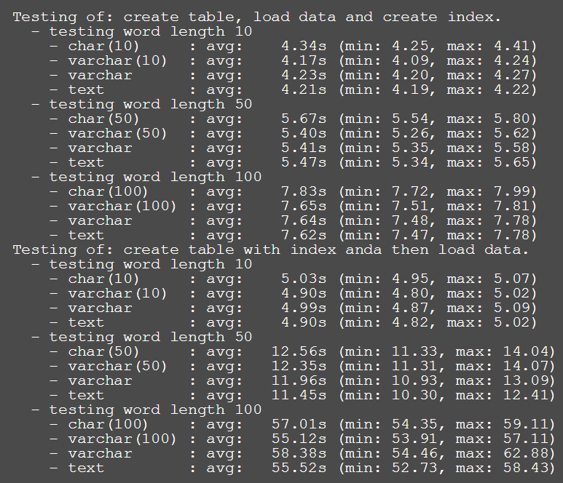
char vs varchar vs text
Test 500.000 rows by Depesz: https://www.depesz.com/2010/03/02/charx-vs-varcharx-vs-varchar-vs-text/

Slide 25
char vs varchar vs text
Just use text if possible, trust me ☺

Slide 26
sequence / serial
Your boosters

Slide 27
sequence / serial
auto-incrementor
# select count(id) from employees;
count
---------
3000002
(1 row)
Time: 339.796 ms
# select last_value from employees_employee_id_seq ;
last_value
------------
3000002
(1 row)
Time: 24.422 ms
14x Faster

Slide 28
sequence / serial
auto incrementor
App Server-1
App Server-2
App Server-3
nextval() ?
Postgres

Slide 29
Our own datatype, yeah!
But be careful. You may dragged into postgres programming

Slide 30
Enum type
Maybe here, or maybe in the programming language

Slide 31
Enum example
create type day as enum ('Monday','Tuesday','Wednesday','Thursday','Friday');
create type working_condition as enum ('Permanent','Contract');

Slide 32
Domain type
Another example

Slide 33
Domain example
create domain postal_code varchar(5)
constraint valid_postal_code
CHECK (VALUE ~ '[0-9-]+');

Slide 34
INDEX

Slide 35
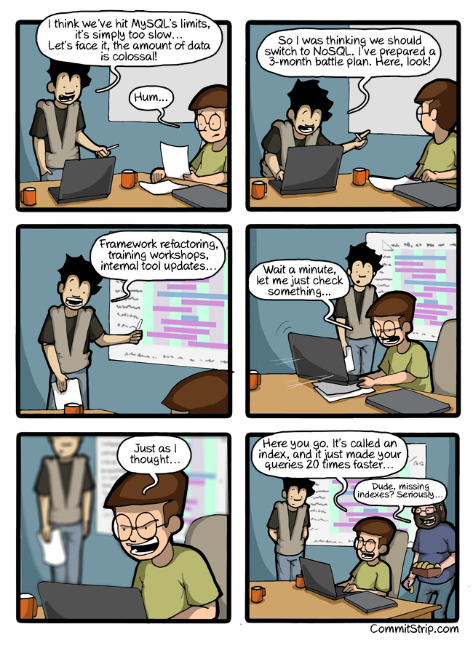

Slide 36
DEMO
select name_first from employees where join_date between '2010-01-01' and '2014-12-31' order by join_date limit 100;
43x Faster

Slide 37
DEMO
select name_first from employees where basic_pay > 10000000 and join_date between '2010-01-01' and '2014-12-31' and working_condition='Permanent' order by basic_pay desc limit 10;
26x Faster

Slide 38
INDEX SIDE EFFECTS
Slow insert

Slide 39
EXPLAIN ANALYZE

Slide 40
Helping analysis
SELECT COUNT(*) FROM "farmer_groups" INNER JOIN "parties" ON "parties"."id" = "farmer_groups"."party_id" INNER JOIN "retailers" ON "retailers"."id" = "farmer_groups"."retailer_id" INNER JOIN "parties" "parties_retailers" ON "parties_retailers"."id" = "retailers"."party_id" LEFT JOIN sales_orgs on farmer_groups.sales_org_id = sales_orgs.id LEFT JOIN parties sales_org_party on sales_orgs.party_id = sales_org_party.id WHERE "farmer_groups"."app_id" = 'bba8db2c-af30-4798-aef7-f881a2a13967' AND "farmer_groups"."sales_org_id" = '4112eaab-4b67-4b5c-b1f6-7a67beb7ce04' AND (lower(
(
SELECT provinces.name AS province
FROM contacts
INNER JOIN party_contacts ON contacts.id = party_contacts.contact_id
LEFT JOIN regions provinces ON contacts.province_id = provinces.id
WHERE party_contacts.party_id = parties.id
AND party_contacts.ident_name = 'FORMAL_ADDRESS'
AND party_contacts.seq = 1
)
) LIKE lower('%sumatera utara%'))

Slide 41
Explain on WEB
Remember DEPESZ?
https://explain.depesz.com/
Let’s try:
explain analyze select name_first from employees where basic_pay > 10000000 and join_date between '2010-01-01' and '2014-12-31' and working_condition='Permanent' order by basic_pay desc limit 10;

Slide 42
FREE-WORKSHOP
- 25 March 2017 -

